Slide 1
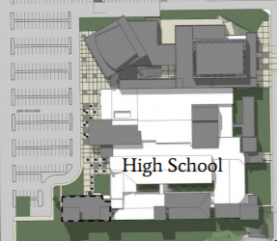
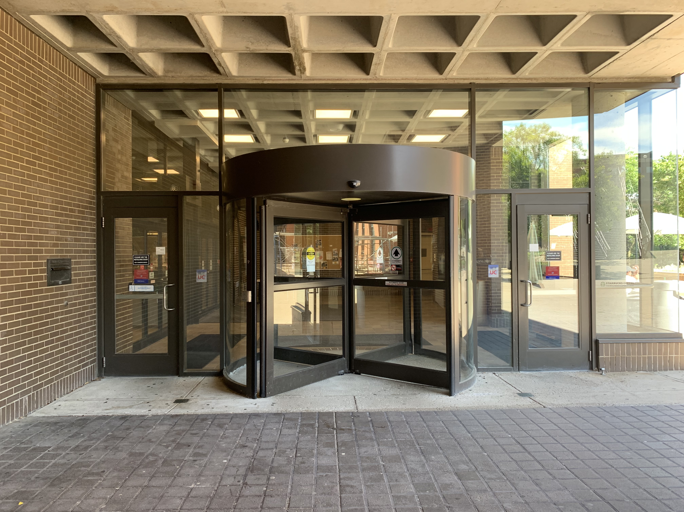
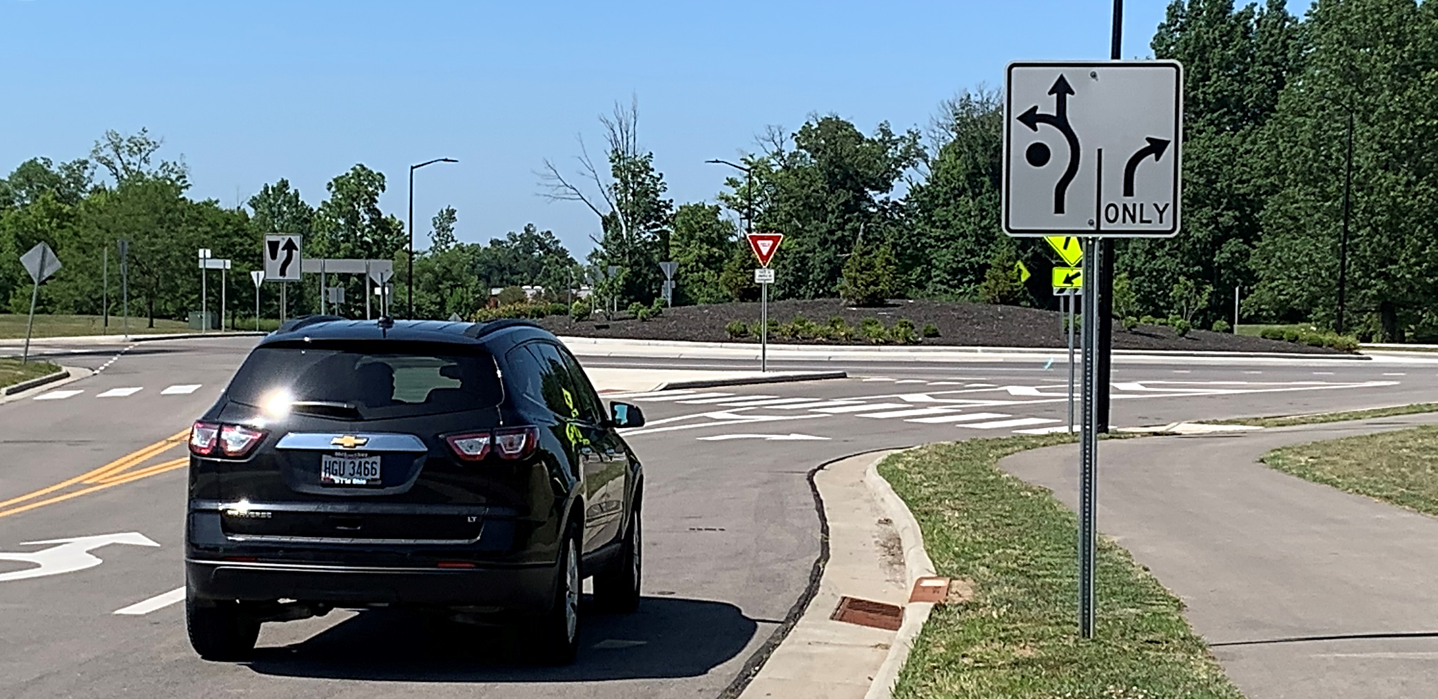
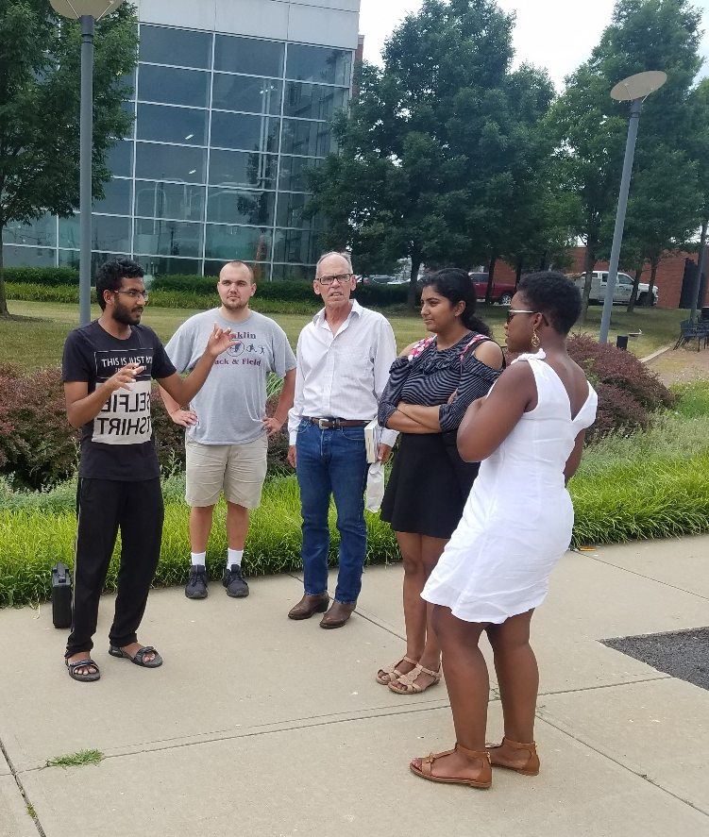
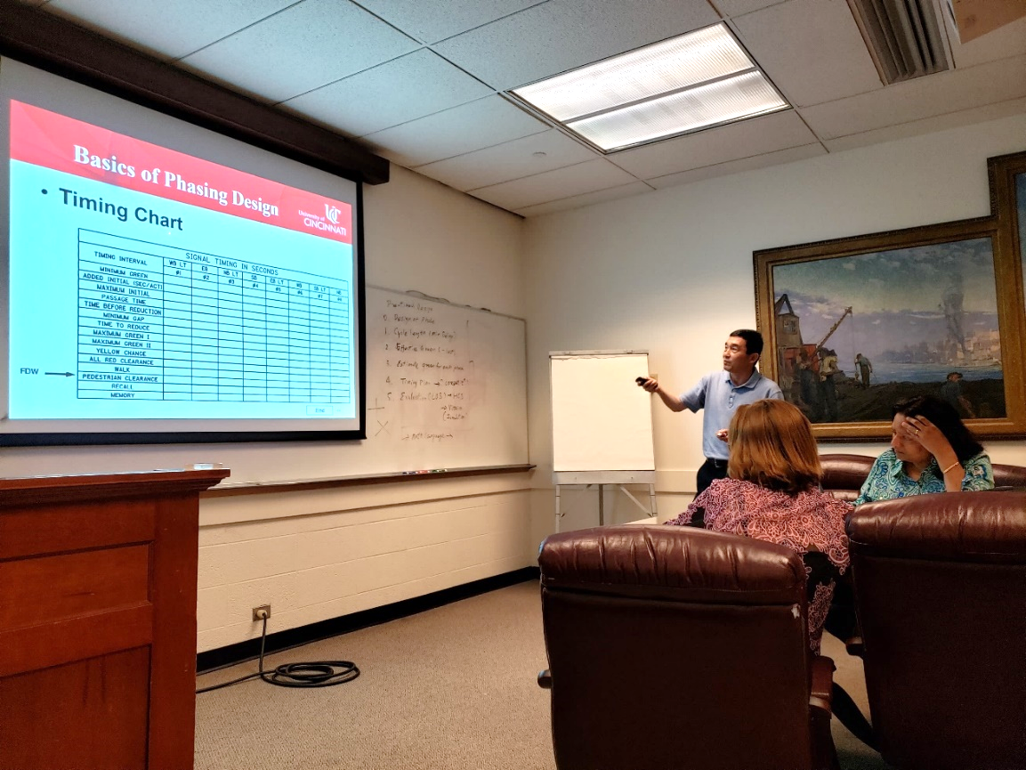
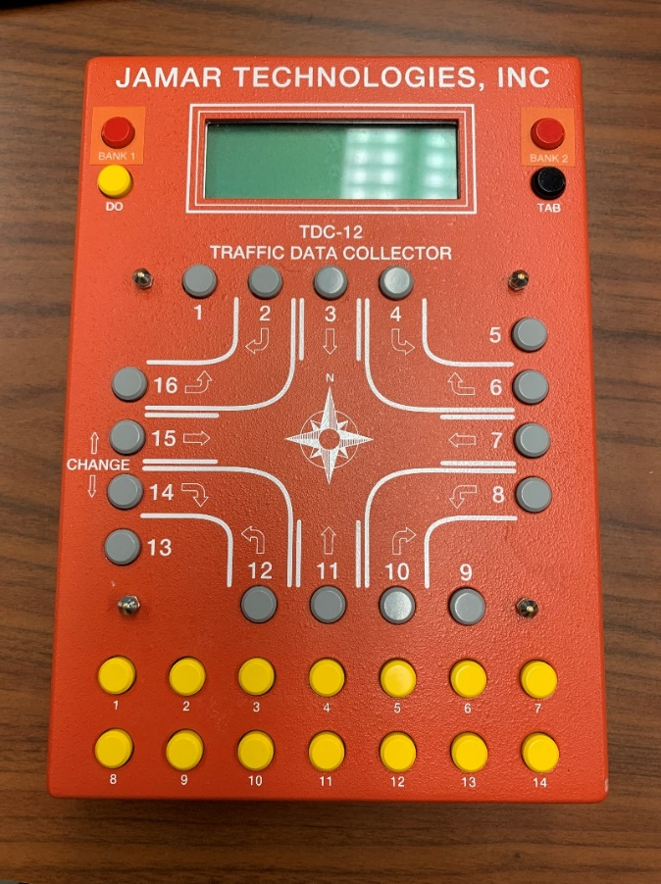
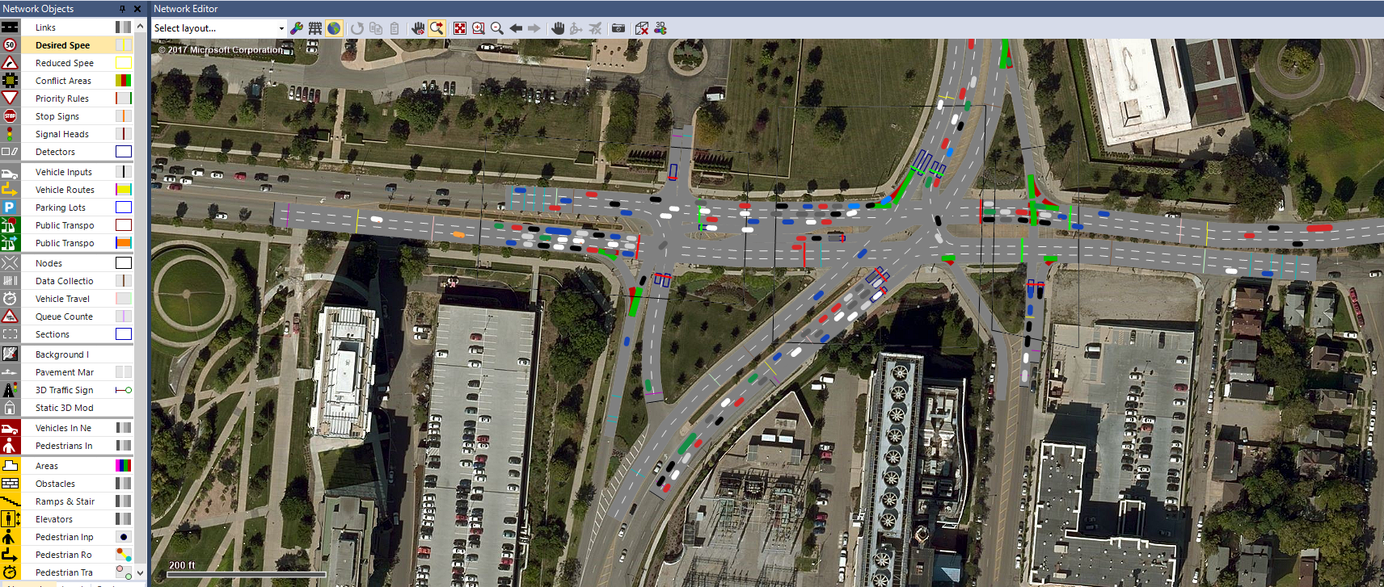
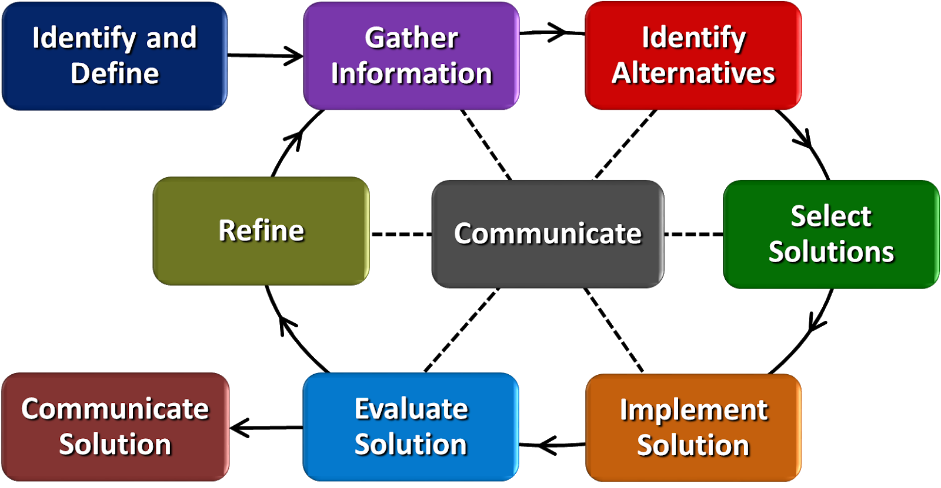
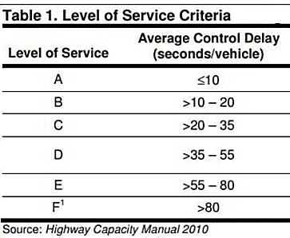
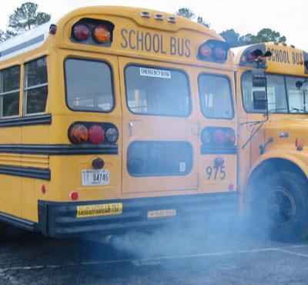
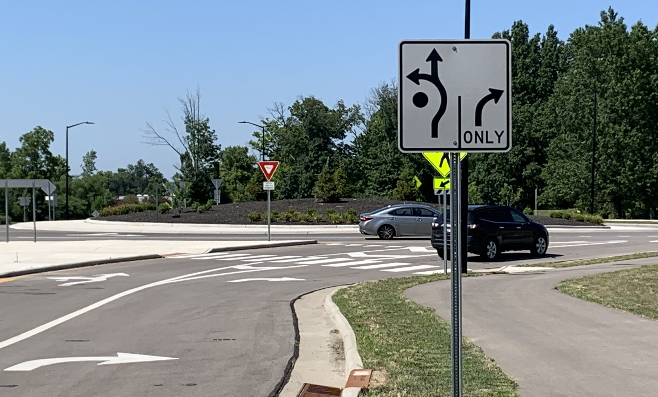
Signalized Intersections Lynn M. Brant Kings High School, Mathematics 9 -12
RET is funded by the National Science Foundation,
grant # EEC-1710826
SUMMER
RESEARCH
CLASSROOM
IMPLEMENTATION
BIG
IDEA
Increase Level of Service on
Martin Luther King Corridor
Real World Applications
How are circles useful in our world?
Field Trips
Mathematical Models
Gathering Data
Career Connections
VISSIM Simulations
Cycle Length Changes
Engineering Design Process
Societal Impact
Viable Solutions

